Slide 1

PANIMALAR ENGINEERING COLLEGE (An Autonomous Institution) Bangalore Trunk Road, Varadharajapuram Poonamallee,Chennai-600 123
DEPARTMENT OF COMPUTER SCIENCE AND ENGINEERING
TITLE:AN AI-GUIDED MODEL DESIGNED FOR THE TIMELY RECOGNITION OF AUTISM SPECTRUM DISORDERS USING ADVANCED MACHINE LEARNING
TEAM NO : D12
TEAM MEMBERS: GUIDE: Mrs. JACKULIN.C.,M.E.,
1. AGNELL J [211420104010] Assistant professor
2. AJEIN MELVIN RAJ A [211420104012] COORDINATOR: Dr. SENTHIL KUMAR.G.,M.E., Ph. D.
3. KISHORE KUMAR K [211420104136] Professor

Slide 2
OVERVIEW
Objective
Abstract
Literature Survey
Existing System
Limitations of Existing System
Proposed System
Advantages of Proposed System
Architecture Diagram
System Required Specifications
List of Modules

Slide 3
OBJECTIVE
The project is to develop an integrated framework for predicting the likelihood of Autism Spectrum Disorder (ASD) in children, with a focus on early detection and intervention.
By combining personalized gaming, quizzing, and MRI analysis, the project aims to create a comprehensive assessment tool that goes beyond traditional behavioral evaluations.
The specific goals include evaluating cognitive abilities and behavioral patterns through engaging puzzle games, assessing social interaction and communication skills via targeted quizzes, and leveraging advanced neuroimaging techniques using the VGG16 network model on MRI images to extract features indicative of ASD pathology.

Slide 4
ABSTRACT
This study introduces a novel and comprehensive framework for predicting the likelihood of Autism Spectrum Disorder (ASD) in children, encompassing a multifaceted approach that incorporates personalized gaming, quizzing, and MRI analysis.
The process initiates with participants inputting their details and engaging in specially designed puzzle games aimed at evaluating cognitive abilities and discerning behavioral patterns.
Following successful completion, participants progress to a quiz round that specifically targets social interaction and communication skills, providing a more holistic behavioral assessment.
Subsequently, the system employs brain MRI images, utilizing the VGG16 network model for analysis, to extract features indicative of ASD pathology.

Slide 5
LITERATURE SURVEY
TITLE OF THE PAPER | AUTHOR | METHODOLOGY USED | DRAWBACK
Hybrid deep transfer learning-based early diagnosis of autism spectrum disorder using scalogram representation of electroencephalography signals | Farhad Abedinzade Torghabehel at. | Deep learning model combines CNN and LSTM | Relatively small dataset size
ASDC-Net: Optimized Convolutionl Neural Network-Based Automatic Autism Spectrum Disorder Classification Using rsfMRI Data | Anjali Chandra el at. | Autism Spectrum Disorder Clinical Diagnosis Network." | SDC-Net approach is the lack of external validation on independent datasets beyond the ABIDE dataset
Cognitive Behavior: Identification of Autism Disorder in Individuals Based on EEG Signal Using Neural Network Network Methods | Ranjani. Metal. | Deep Learning (DL) models, including LSTM, CNN, and MLP | Limited explanation or exploration of potential confounding factors or biases in the EEG data collection process
YEAR OF PUBLICATION
2024
2023
2023

Slide 6
LITERATURE SURVEY
TITLE OF THE PAPER | AUTHOR | METHODOLOGY USED | DRAWBACK
The diagnosis of ASD using multiple machine learning techniques | Chandan Jyoti Kumar etal. | Machine learning techniques | Potential overfitting of the machine learning models to the dataset
Machine Learning Data Analysis Highlights the Role of Parasutterella and All oprevotella in Autism Spectrum Disorders | Daniele Pietruccial. | Fecal sample sequencing and machine learning analysis. | Introduced by combining data from different projects, which may lead to inconsistencies or inaccuracies
YEAR OF PUBLICATION
2022
2021

Slide 7
EXISTING SYSTEM
Autism Detection in Early Childhood (ADEC):Detects ASD signs in infants through eye-tracking during natural interactions, but faces challenges in data availability and generalization.
Early Autism Detection and Intervention (EADI):Analyzes infant vocalizations for ASD risk, yet lacks specificity and raises ethical concerns regarding privacy.
Multimodal Screening for Autism Risk (MSIAR):Integrates multiple data sources to assess ASD risk in children, yet requires extensive resources and faces overfitting risks.
Brain Imaging-based Approaches: Utilizes MRI scans to detect neuroanatomical differences in ASD, but faces accessibility issues and complexity in interpretation.

Slide 8
LIMITATIONS OF EXISTING SYSTEM
Faces challenges in data availability and generalization.
Lacks specificity and raises ethical concerns regarding privacy.
Relies on subjective interpretation.
Subject to recall bias and interpretation challenges.

Slide 9
PROPOSED SYSTEM
The proposed system for this project presents a pioneering approach to Autism Spectrum Disorder (ASD) detection, focusing on the integration of facial image analysis as the cornerstone of our diagnostic framework.
Our system seeks to leverage advanced computer vision techniques to extract meaningful insights from facial features, aiming for a non-intrusive and efficient means of identifying potential ASD indicators. By employing state-of-the-art algorithms and machine learning models tailored to facial image analysis, our system aims to discern subtle patterns and expressions associated with ASD traits.
These interactive components aim to capture cognitive abilities, behavioural patterns, and social interaction skills, providing a more comprehensive assessment.

Slide 10
ADVANTAGES OF PROPOSED SYSTEM
Increased Sensitivity and Specificity
Early Intervention Opportunities
Personalized Approach
Holistic evaluation

Slide 11
HARDWARE AND SOFTWARE SPECIFICATION
Software requirements | Hardware requirements
Operating System - Windows above 8, MacOS, Linux | Processor - Intel Core i5 or higher
Scripts - Python Language | RAM - 8 GB
Tool - Python IDLE 3.10 | Hard Disk - Above 500 GB

Slide 12
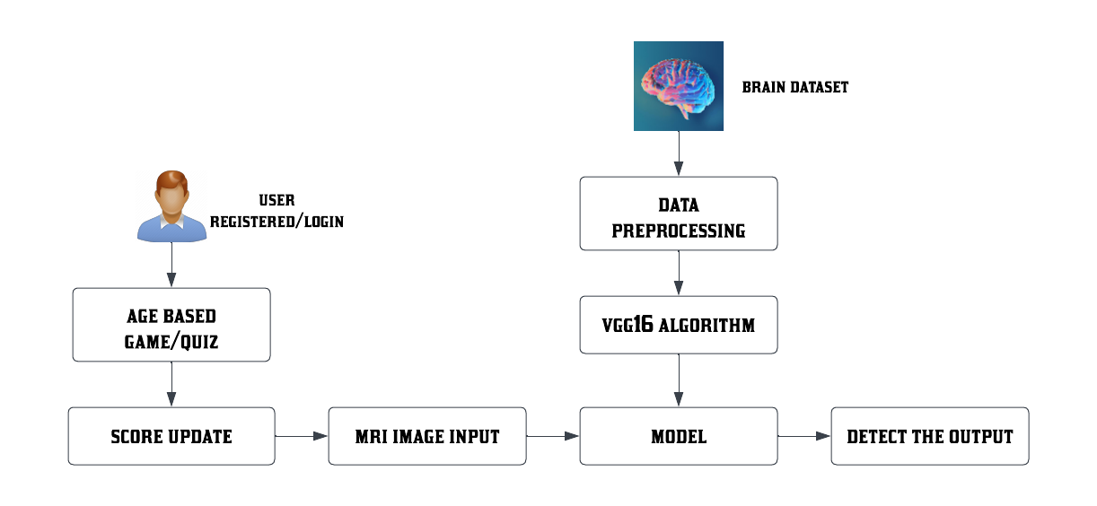
ARCHITECTURE DIAGRAM

Slide 13
LIST OF MODULES
Exploratory Data Analytics
Genesis of VGG16
Age Based Game
Model Creation
Autism Detection

Slide 14
MODULE 1
EXPLORATORY DATA ANALYTICS:
Data pre-processing within this project plays a pivotal role in refining and optimizing the raw sensor data collected from smartphones, making it suitable for analysis and early autism detection. The pre-processing stage encompasses activities such as data cleaning, noise reduction, and feature extraction, ensuring that the data is of high quality and aligned with the requirements of the subsequent algorithms.
By effectively preparing the data, we enhance the accuracy and reliability of the analysis, ultimately enabling a more precise assessment of children's behavioural patterns, thus facilitating early ASD detection and intervention.
This critical data pre-processing step ensures that the project's algorithms can operate on a robust dataset, contributing to the overarching goal of improving the lives of children with autism by enabling timely support and care.

Slide 15
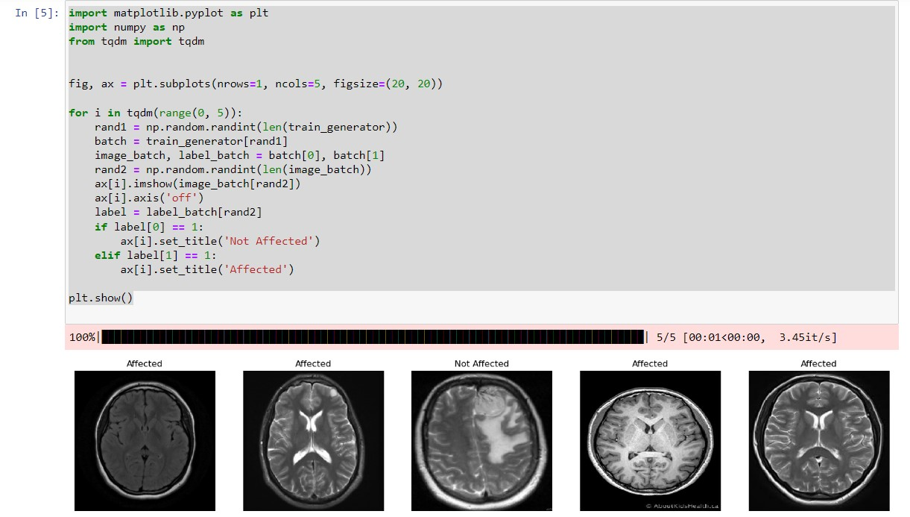
OUTPUT
Data pre-processing

Slide 16
MODULE 2
GENESIS OF VGG16:
The VGG16 is a remarkable advancement in deep learning and computer vision. It has made its mark by demonstrating its prowess in recognizing complex features in images. With a deep layer learning architecture, VGG16 is well-suited for image recognition tasks, including the critical task of emotion recognition in this project.
Its exceptional ability to analyse intricate facial expressions and non-verbal cues facilitates the accurate interpretation of emotions, particularly in children with Autism Spectrum Disorder, where understanding and expressing emotions can be particularly challenging.
VGG16 plays a pivotal role in enabling emotional recognition in various contexts and stands as a crucial component in enhancing the emotional well-being and social interactions of individuals with autism.

Slide 17
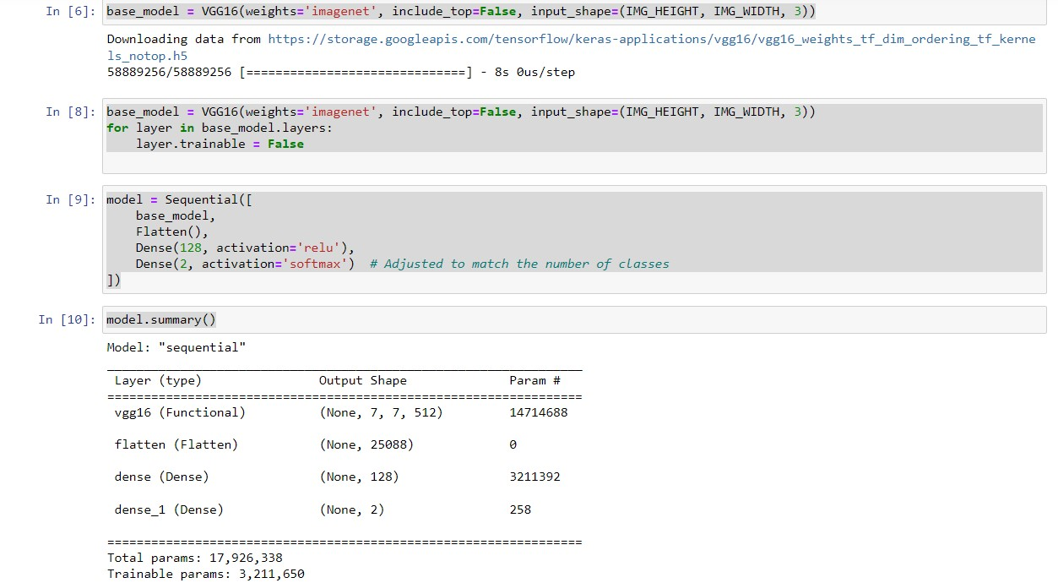
OUTPUT
Inception of VGG16

Slide 18
MODULE 3
AGE BASED GAME:
This module focuses on designing and implementing personalized gaming and quizzing activities tailored to the age group of the participants.
The games and quizzes are designed to assess cognitive abilities, social interaction, and communication skills, which are key factors in ASD prediction.
The content and difficulty level of the games/quizzes may vary based on the age of the participants to ensure engagement and accuracy in assessment.

Slide 19


OUTPUT
Game for(3-9)
Game for (10-20)

Slide 20
MODULE 4
MODEL CREATION:
In this module, a predictive model for ASD likelihood is created by integrating behavioral assessment outcomes and neuroimaging data.
The model may utilize VGG16 to combine the information obtained from personalized gaming, quizzing, and MRI analysis.
The goal is to develop a comprehensive and accurate predictive model for ASD detection.

Slide 21
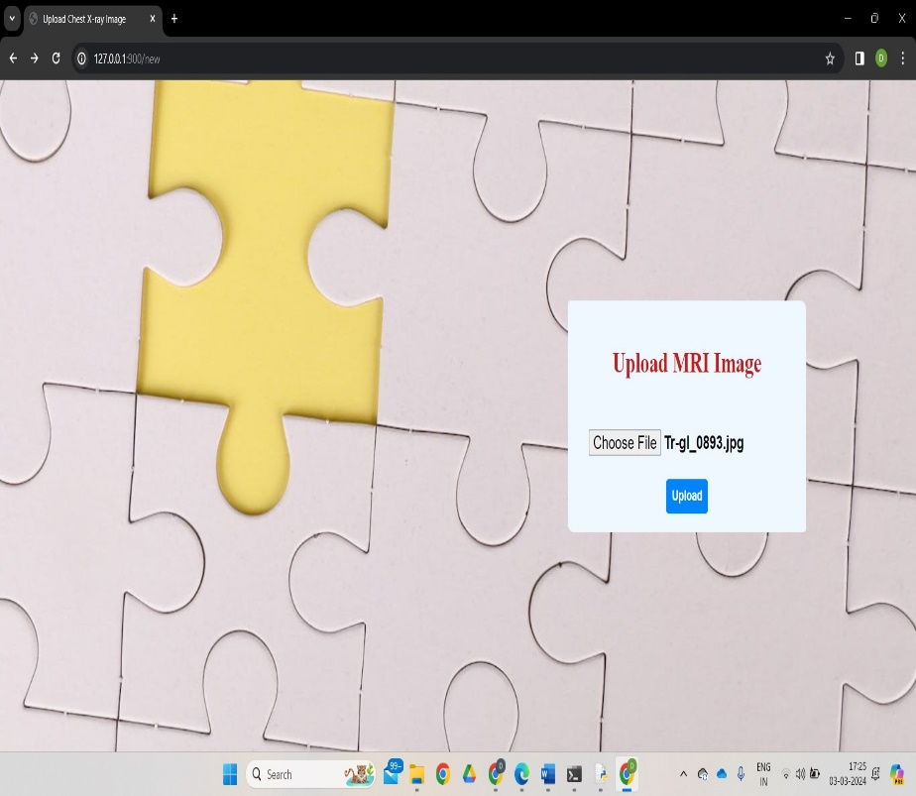
OUTPUT
Uploading of MRI images

Slide 22
MODULE 5
AUTISM DETECTION:
In the Autism Detection module, the integrated framework utilizes age-based game and quiz scores alongside MRI image inputs to detect autism spectrum disorder (ASD) likelihood.
The module combines the outcomes from personalized gaming and quizzing activities, reflecting participants' cognitive abilities and social interaction skills. These scores are integrated with features extracted from MRI images, providing a comprehensive assessment of ASD risk.
Through the seamless fusion of behavioural assessment outcomes and neuroimaging data, the module determines the likelihood of ASD for each participant. This holistic approach ensures accurate and timely detection of ASD, facilitating early interventions and support for affected individuals.

Slide 23
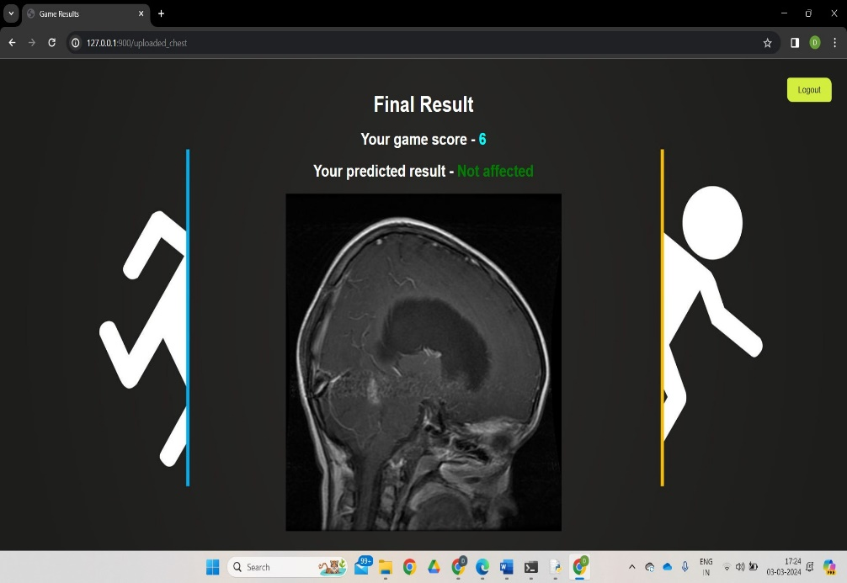
OUTPUT
Output Display

Slide 24
CONCLUSION
The Integrated Framework for Autism Prediction, incorporating personalized gaming, quizzing, and MRI analysis using the VGG16, represents a significant advancement in early ASD detection.
By leveraging personalized gaming and quizzing activities, the framework assesses cognitive abilities, social interaction, and communication skills, providing valuable insights into ASD risk factors.
Additionally, MRI analysis using the VGG16 enables the extraction of features indicative of ASD pathology from brain images, further enhancing the predictive capabilities of the framework.
In conclusion, the Integrated Framework for Autism Prediction holds immense potential in revolutionizing the early detection and intervention of ASD.

Slide 25
FUTURE ENHANCEMENT
Future enhancement within this project plays a pivotal role in refining and augmenting the quality and discriminative power of the data. It encompasses various techniques, including feature engineering and data transformation, aimed at highlighting critical characteristics in the dataset.
To further enhance the capabilities of the Integrated Framework for Autism Prediction, several feature enhancements can be considered, Integration of additional assessment modalities, such as eye-tracking technology or speech analysis, to provide a more comprehensive evaluation of ASD risk factors.
Implementation of advanced machine learning algorithms to improve the accuracy and efficiency of the predictive model. Development of personalized intervention strategies based on the individualized assessment results, tailored to the specific needs of each participant.

Slide 26

SCREENSHOTS Registration Page

Slide 27

LOGIN PAGE

Slide 28


GAME PAGE

Slide 29

MRI IMAGE UPLOADING

Slide 30
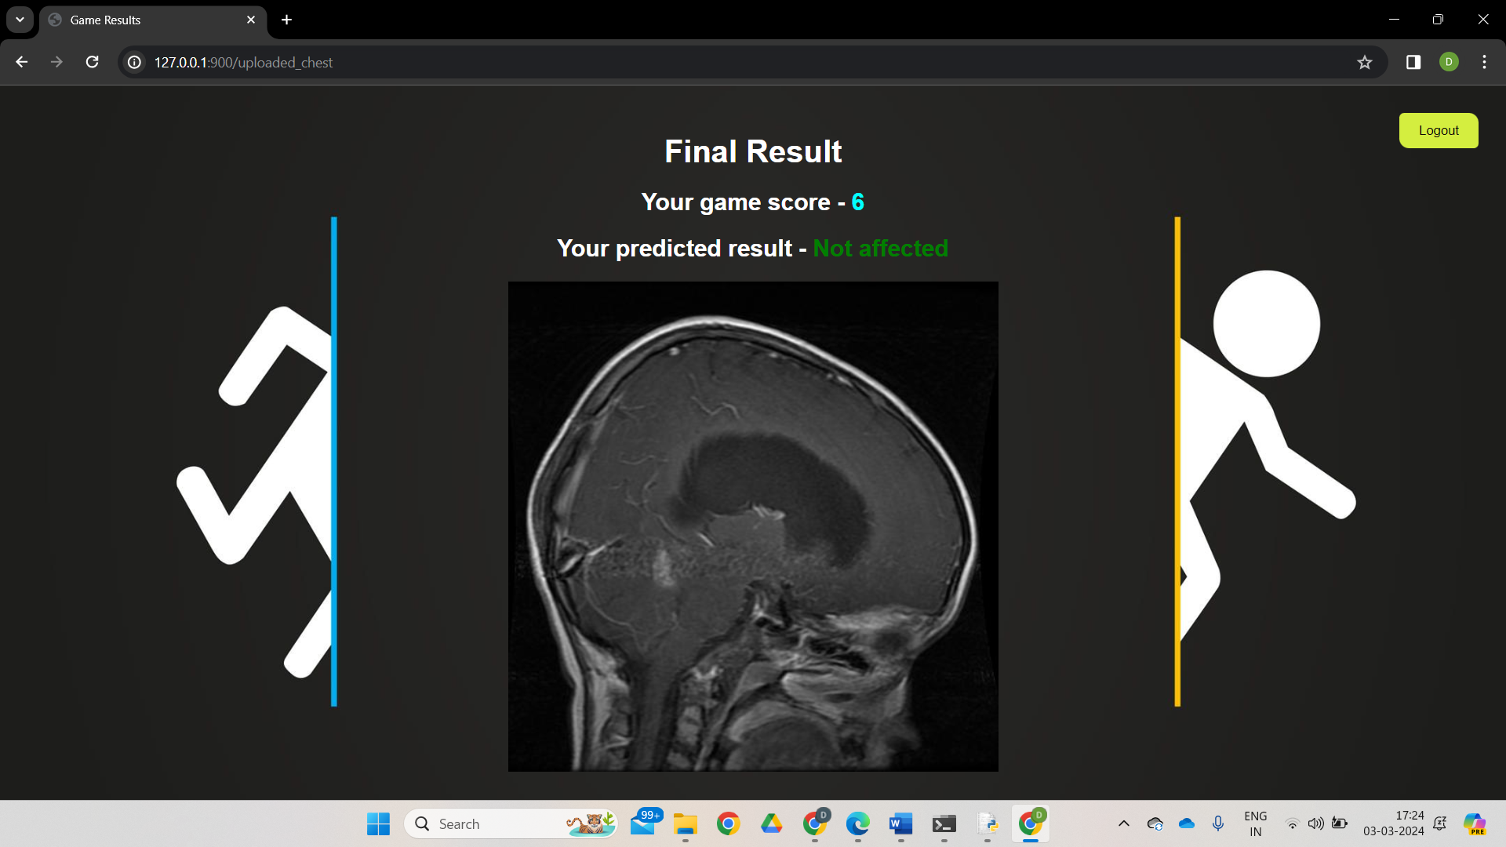
RESULT

Slide 31
REFERENCES
M. Bala, M. H. Ali, M. S. Satu, K. F. Hasan, and M. A. Moni, ‘‘Efficient machine learning models for early stage detection of autism spectrum disorder,’’Algorithms, vol. 15, no. 5, p. 166, May 2022
D. Pietrucci, A. Teofani, M. Milanesi, B. Fosso, L. Putignani, F. Messina, G. Pesole, A. Desideri, And G. Chillemi, ‘‘Machine Learning Data Analysis Highlights The Role Of Parasutterella And Alloprevotella In Autism Spectrum Disorders,’’ Biomedicines, Vol. 10, No. 8, P. 2028, Aug. 2022.
F. Z. Subah, K. Deb, P. K. Dhar, and T. Koshiba, ‘‘A deep learning approach to predict autism spectrum disorder using multisite resting-state fMRI,’’ Appl. Sci., vol. 11, no. 8, p. 3636, Apr. 2021.
K.-F. Kollias, C. K. Syriopoulou-Delli, P. Sarigiannidis, and G. F. Fragulis, ‘‘The contribution of machine learning and eye-tracking technology in autism spectrum disorder research: A systematic review,’’ Electronics, vol. 10, no. 23,p. 2982, Nov. 2021.
A. Ahmed, E. M. Senan, T. H. Rassem, M. A. H. Ali, H. S. A. Shatnawi, S.M. Alwazer, and M. Alshahrani, ‘‘Eye tracking-based diagnosis and early detection of autism spectrum disorder using machine learning and deep learning techniques,’’ Electronics, vol. 11, no. 4, p. 530, Feb. 2022.

Slide 32
THANK YOU

